Slide 1

Beyond a Single Prompt: Building Consistent LLM Characters
Team Checkpoint 3
Gawon Lim, Flynn Huynh, Kiara Gao
github.com/FlinnH/IS492-CharacterAI-Team-Project
LLM characters break after about ten turns, and their creators can’t tell what broke or why.
Notes:
[Speaker notes: paste slide 1 “Say” text from CP3_SLIDE_TEXT.md]

Slide 2
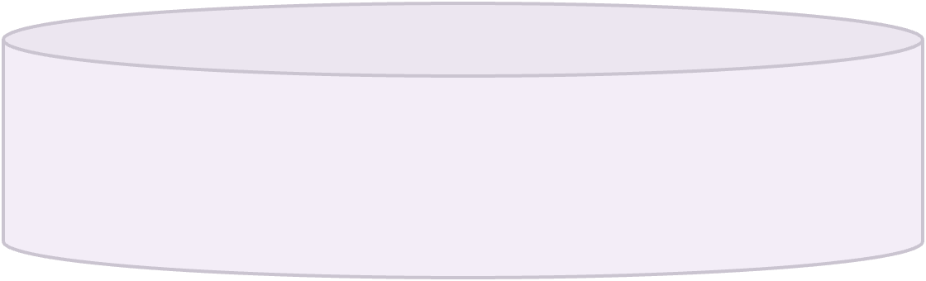
How it fits together
Your computer
Live streaming
Gemini 3.1 Flash-Lite
Browser
FastAPI server
Model gateway
Plays the character
Spec editor, Run a conversation, Flag review, Compare runs
Specs, chats, AI judge, automatic checks, evidence checks
Limits, retries, fallback model, logging
Model calls
Gemini 3.5 Flash-Lite
Judges the chat
SQLite
Or another model in Settings
Specs, chats, flags, and every model call
Python
FastAPI
SQLite
HTML, CSS, JavaScript
426 automated tests
Every prompt carries the full spec, about 2,850 tokens, so each flag traces back to a numbered line.
2
Notes:
[Speaker notes: paste slide 2 “Say” text from CP3_SLIDE_TEXT.md]

Slide 3

Live demo
Define
Stress-test
Diagnose
Decide
3
Notes:
[Speaker notes: paste slide 3 “Say” text and “Do in the app” steps from CP3_SLIDE_TEXT.md]

Slide 4



Live demo: when things go wrong
A follow-up question from the creator
A planted instruction in a chat
A busy AI service
4
Notes:
[Speaker notes: paste slide 4 “Say” text and “Do in the app” steps from CP3_SLIDE_TEXT.md]

Slide 5
What we decided and what we found
Structured spec
Two models
Versioned prompts
Free by default
Every rule has a line ID that a flag can cite
One writes the character, a different one judges
Every model call logs the exact version
$0 on Gemini’s free tier, and any OpenAI-compatible model works
Same seeded chat, 7 planted mistakes. Caught means the right line and the right failure type.
With a general question
With a specific question
What stands out
Right line, alone
Caught, alone
Wrong flags
Reviewer
One question from a person took the free model from 4 to 6
The stronger models found every line alone, but sometimes misnamed the failure
Paid rates would be about $0.001 to $0.002 per reply and about $0.002 per judge call
A person alone (CP2)
Not recorded
0 of 7
N/A
N/A
0
Gemini 3.5 Flash-Lite (free)
Not recorded
4 of 7
5 of 7
6 of 7
0
GPT 6.1 Sol
7 of 7
4 of 7
4 of 7
4 of 7
0
Claude Opus 5.5
7 of 7
6 of 7
6 of 7
6 of 7
0
One chat, one run per model. This isn’t a benchmark.
5
Notes:
Four decisions shaped the app: a spec with line IDs, separate models for writing and judging, versioned prompts, and a free default so anyone can run it. Then we tested it on a chat with 7 planted mistakes. A person alone caught none in CP2. Our free model caught 4, and one specific question from a person brought it to 6. GPT and Claude found the right line for all 7 alone, but sometimes named the wrong failure type, and the questions didn’t change their scores. This is one chat, and we wrote the specific question already knowing what the AI missed in CP2, so 6 of 7 is a best case.

Slide 6
We don’t trust the model’s output by default
AI flags
Code checks every quote and spec line
Creator decides
Failed checks are hidden and counted
Risk
What we do
What it can’t do yet
Personal data
Removes emails, phone numbers, and keys before anything is saved or sent
Names and addresses stay
Prompt injection
Sends the chat to the judge as data, and marks suspicious lines
A reworded line can get through
Made-up flags
Hides any flag whose quote or spec line isn’t real, and counts it
Can’t catch a mistake the AI never flagged
Rubber-stamping
Locks Agree until the evidence is opened, and an override needs a reason
Can’t make someone read carefully
Outages and cost
Retries, a fallback model, 15 calls a minute, and 200 calls a day by default
The fallback covers Gemini only
Specs, chats, and keys stay on the creator’s computer. Chat text is sent only to the model service they choose.
6
Notes:
We treat every AI answer as a claim to check. Code verifies each flag against the real chat, so an invented quote never reaches the creator. The chat goes to the judge as data, not as instructions, and Agree stays locked until you’ve seen the evidence. We list what each guardrail can’t do, because a reworded injection could still sway the judge. That’s why the automatic checks and the creator’s review are the backstop.

Slide 7

Can a creator with AI beat either one alone, and why?
Our claim breaks if AI alone matches the team, if creators approve every flag, or if both miss the same failures.
1
What does the person add?
2
Does showing evidence stop rubber-stamping?
Stronger models found every line alone, so the person’s value may move from finding failures to judging them.
We plant one wrong flag and log who opens the evidence.
3
Which part improves consistency?
4
Does it hold for a new character?
We turn memory and retrieval on and off against today’s spec-only baseline.
Models already know Harry Potter, so we test a character with nothing online.
Person alone
AI alone
Creator with the workbench
Same new test chat. We measure caught, missed, false alarms, and minutes.
Limits so far: one chat, one character, and one run per model.
7
Notes:
This is a research question as much as a tool: when does a person and an AI together beat either one alone? Our own test challenges that claim, because stronger models found every line alone, so the person’s value may be in judging rather than finding. In CP4 we’ll compare all three setups with real creators on a new test chat, because the first chat’s answers are public. We’ll also measure rubber-stamping, test which components actually help, and try a character the models have never seen.

Slide 8





From a class project to a consistency platform
Anyone who needs an AI character to stay itself, at scale.
Virtual character creators
AI short-drama studios
Game and narrative teams
Companion and role-play apps
Problem: The persona drifts as fans keep talking to it.
Problem: Characters change across scripts and episodes.
Problem: NPCs reveal what they shouldn’t know yet.
Problem: A model update can quietly change a character.
Gives: A character bible that every reply is checked against.
Gives: Continuity checks before anything goes to production.
Gives: Knowledge-boundary tests for each story stage.
Gives: Regression runs before each model change.
Same core everywhere: a structured spec, automated stress tests, evidence for every flag, and a person making the final call.
Today: one character on one computer
Next: memory, retrieval, and many characters
Later: team review and an API for generation pipelines
This is our direction. We haven’t validated it with these groups yet.
8
Notes:
Today this is one character on one laptop, but the problem is much bigger. Virtual character creators, AI short-drama studios, game teams, and companion apps all need a character to stay itself across thousands of lines. The core stays the same: a structured spec, stress tests, evidence, and a person making the call. We haven’t validated this with those groups yet, but that’s where we want to take it.

